Slide 1
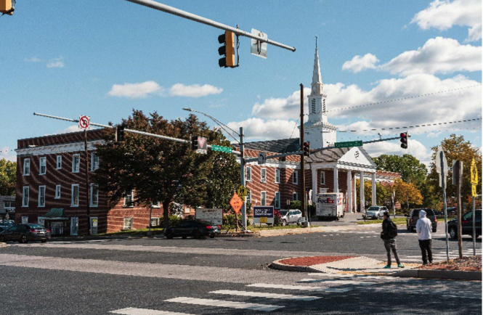
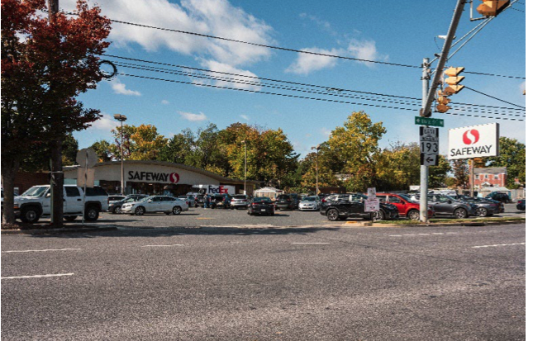
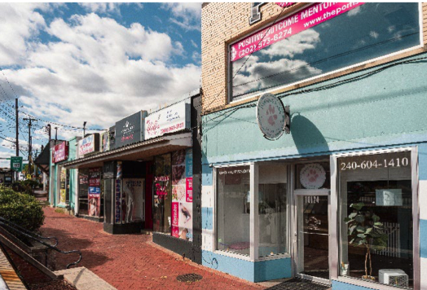
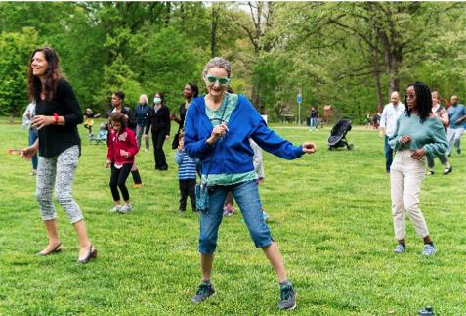
University Boulevard Corridor Plan
NORTHWOOD FOUR CORNERS CIVIC ASSOCIATION
November 10, 2025

Slide 2
UNIVERSITY BOULEVARD CORRIDOR PLAN (UBCP)
PLAN VISION
Pedestrian-oriented
Multimodal
Safe, accessible, and healthy travel options
Vibrant, connected communities
Diverse range of housing options
Supported by Bus Rapid Transit (BRT)

Slide 3
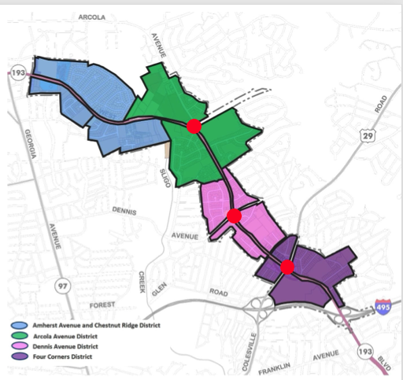
PLAN FRAMEWORK
FOUR DISTRICTS in UBCP
3 Future BRT Stops
NFCCA focus:
Arcola Ave District
Dennis Ave District
Four Corners District

Slide 4
Urban Design Strategy
Environmental Sustainability
Promote transit-supportive development near BRT
Expand housing choice on properties fronting University Blvd. between planned BRT stops
Identify multimodal improvements
Recommend developing University Blvd. as “Cool Corridor”
Tree canopy, shaded transit shelters
Runoff reduction landscaping
Design for trees, reduce utility line conflicts
Increase tree canopy and landscaping
Promote energy conservation options for redevelopment

Slide 5
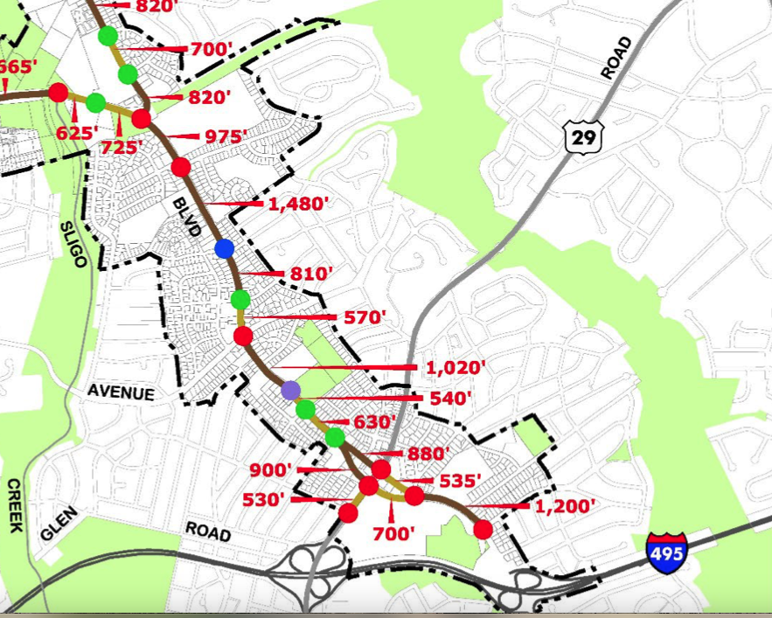
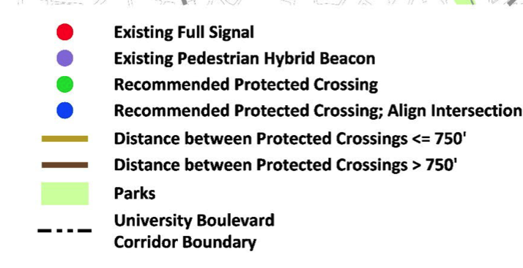
Transportation
Complete network of comfortable sideways and bikeways connected by safe protected crossings
Support opportunities for micro-mobility, bike share and electric charging stations

Slide 6
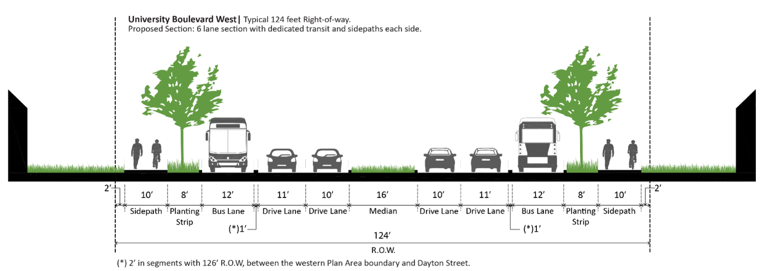
Transportation -- University Boulevard
10’ buffered sidepaths on both sides of University Blvd.
Dedicated transit lanes along University Blvd. and Colesville Rd. except for area near Four Corners intersection
With redevelopment or BRT implementation consolidate, remove, or relocate driveways on University Blvd.

Slide 7
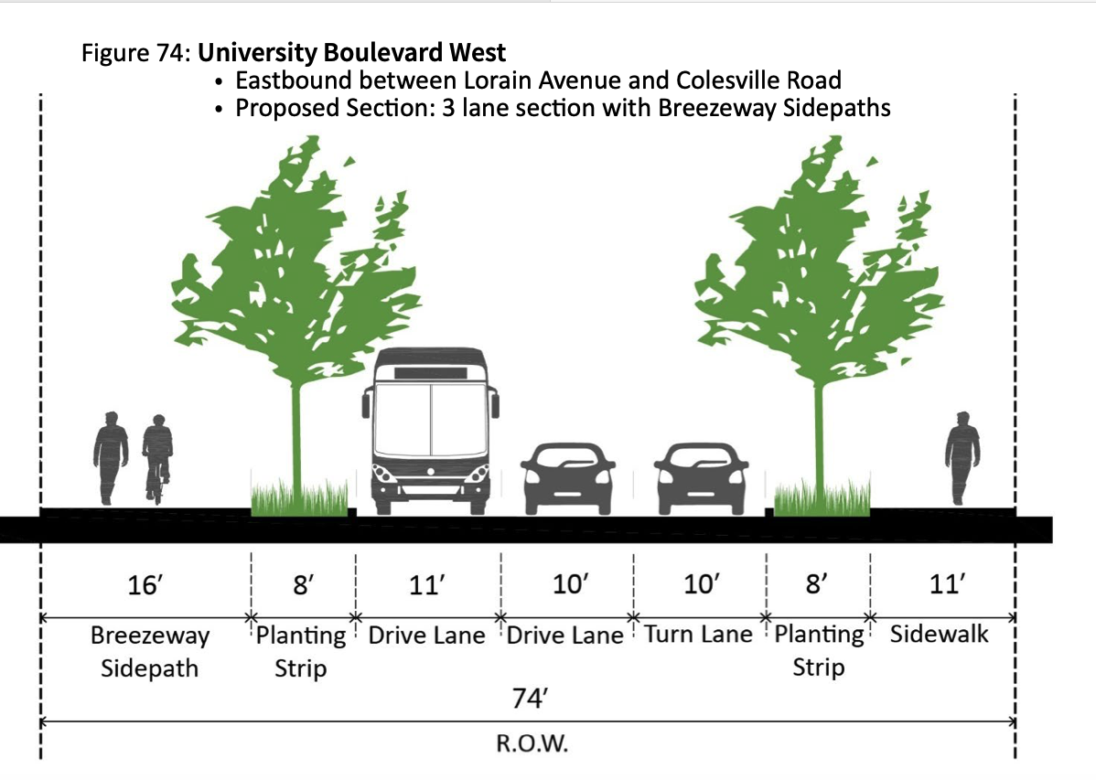
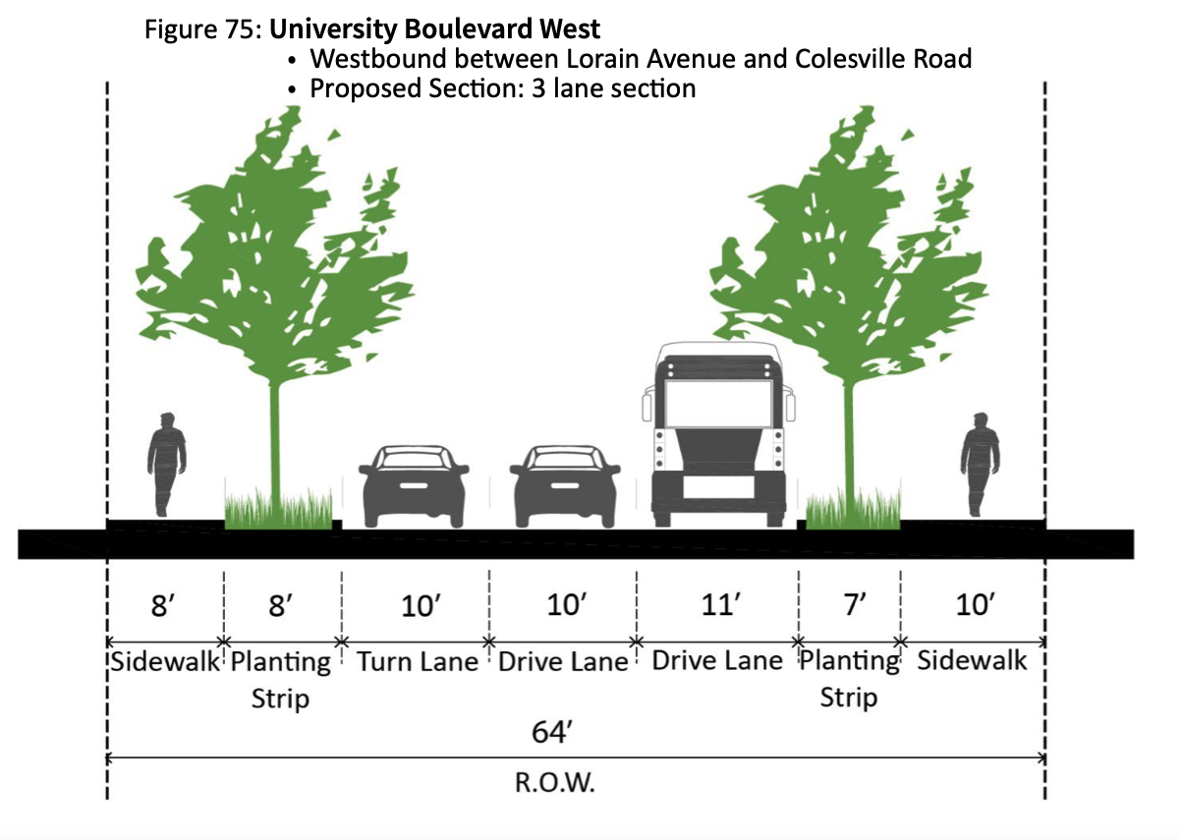
Transportation – Four Corners
Lorain to Colesville Rd. – East & West

Slide 8
Transportation – Four Corners
In near-term maintain existing couplet
Repurpose one lane in each direction for buffer and wider sidewalk or sidepath
Study additional street connections to achieve long-term vision for more connected network and regular street pattern
Study options for improving transit performance, multimodal safety, human scale, and street buffers over traffic capacity and travel speed

Slide 9
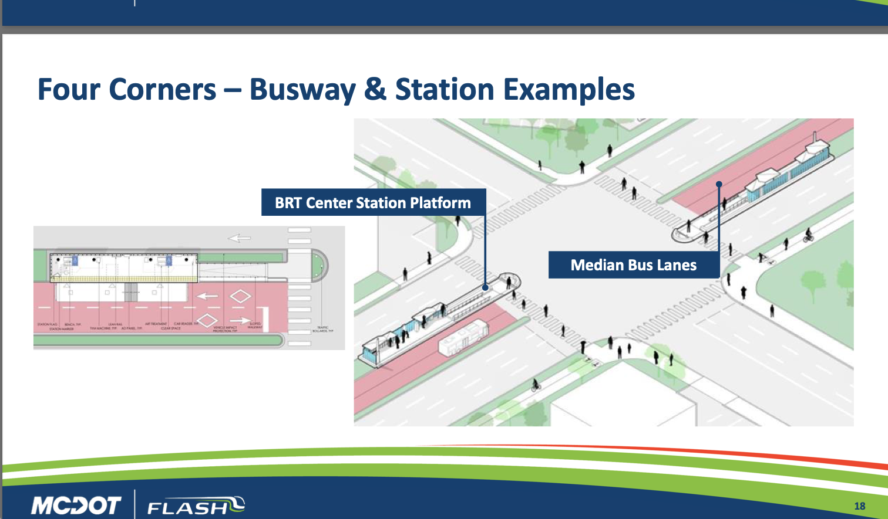
Transportation Four Corners—BRT Station

Slide 10
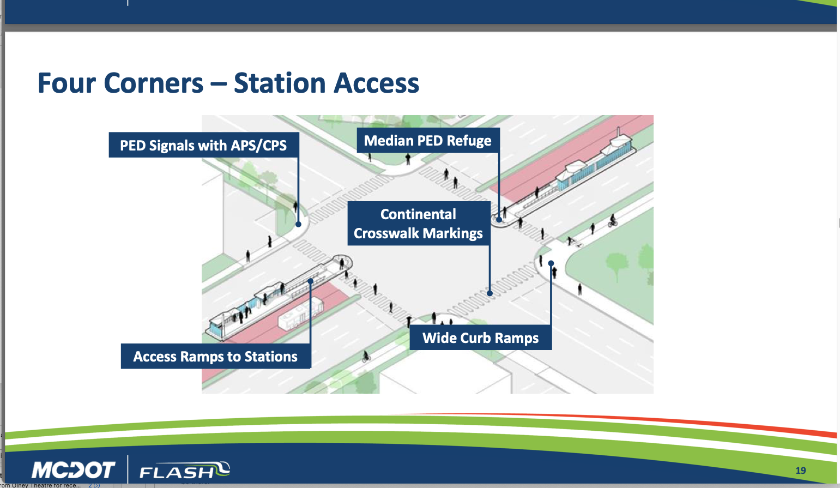
Transportation Four Corners—BRT Station

Slide 11
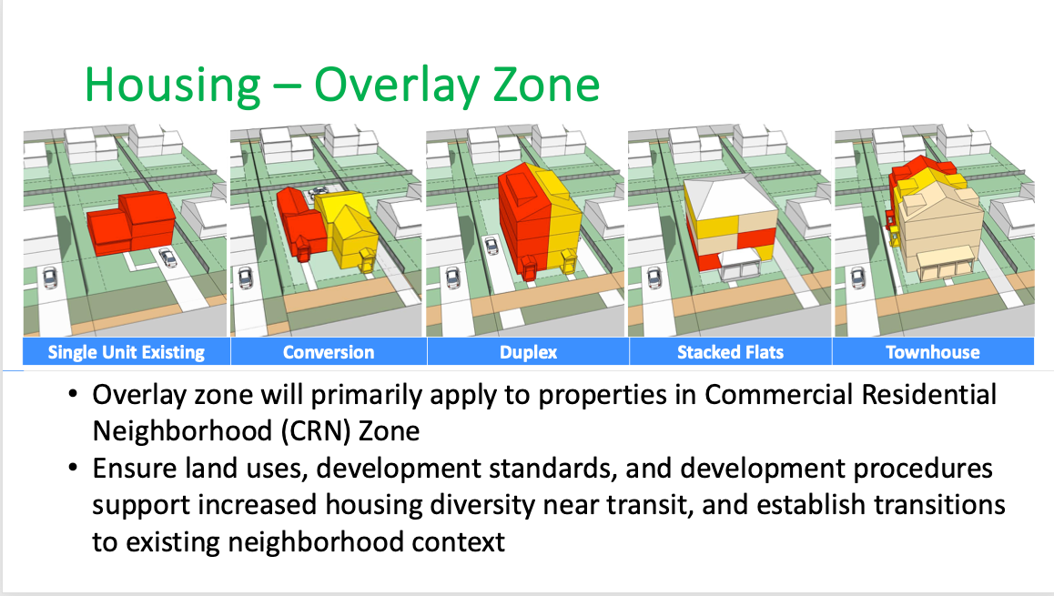

Slide 12
Floor Area Ratio (FAR)
FAR limits:
Maximum square footage of building compared to lot size
Mix of uses for residential or commercial/retail
Example: Lot with 10,000 square feet
FAR of CRT 2.25, C-1.5, R-2.0, Height 60
Maximum building size is 22,500 square feet
Developer decides ratio of commercial vs residential
15000 sq.ft. commercial & 7500 sq.ft. residential
2250 sq.ft. commercial & 20000 sq.ft. residential
5000 sq.ft. commercial & 17500 sq.ft. residential
Residential
Residential
Commercial

Slide 13
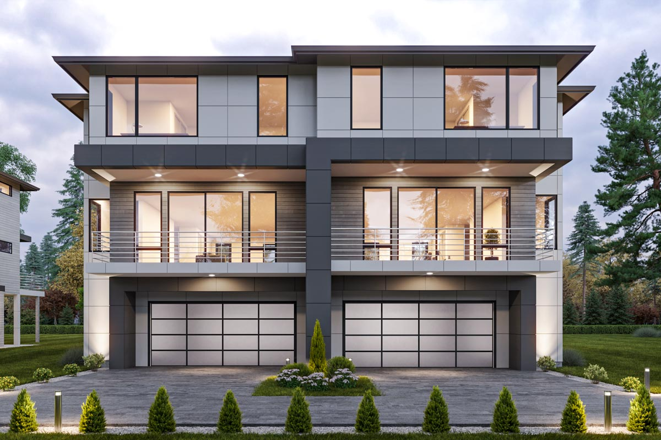
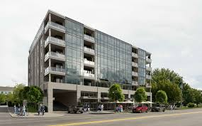
Commercial Residential Neighborhood
Arcola Avenue
BRT District
Homes on University Boulevard and
Whittington Terrace (NFC) or
Breezewood (SFC)
Maximum Building FAR is 1.0 times lot size
Residential only.
Height 45’
Commercial Residential Town
Religious Institution Properties
(Luther Rice, Shomrai Emunah)
Maximum Building FAR is 1.5 times lot size
Commercial FAR is .25
Residential FAR is 1.5
Height 60’

Slide 14
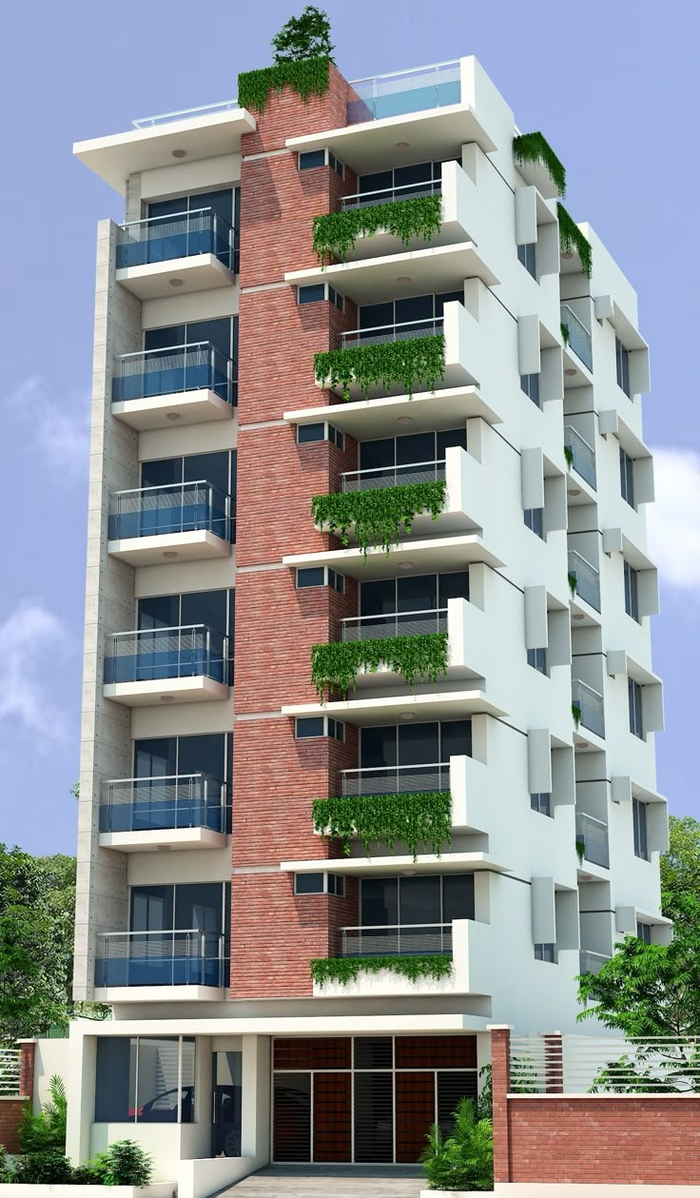
Dennis Avenue -- BRT District
Commercial Residential Neighborhood
Maximum building FAR is 1 x lot size
Residential only
Height 45’
Commercial Residential Town
The Oaks
Maximum FAR 1.5
Commercial 0.25
Residential 1.5
Height 70’

Slide 15
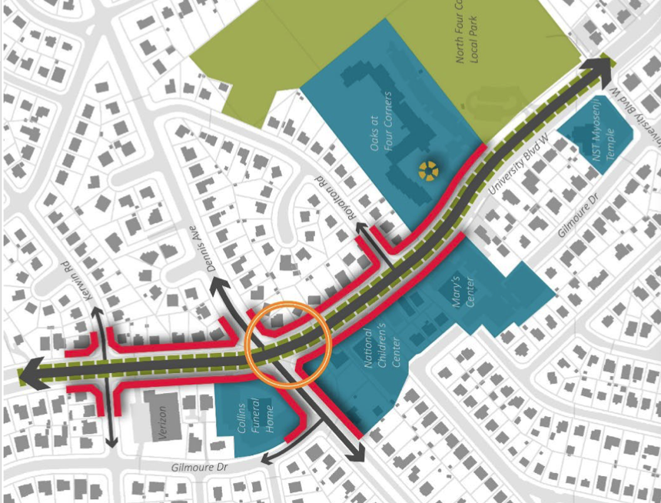
Dennis Avenue -- BRT District
Commercial Residential Town
Collins Funeral Home
Maximum Building FAR is 1.5 x lot size
Commercial FAR 0.5
Residential FAR 1.25
Height 60’
4 Homes on University
Verizon substation
Maximum Building FAR is 1 x lot size
Commercial FAR 0.0
Residential FAR 1.0
Height 45’
Red = Build to Line
University Blvd & Dennis Avenue
intersection

Slide 16
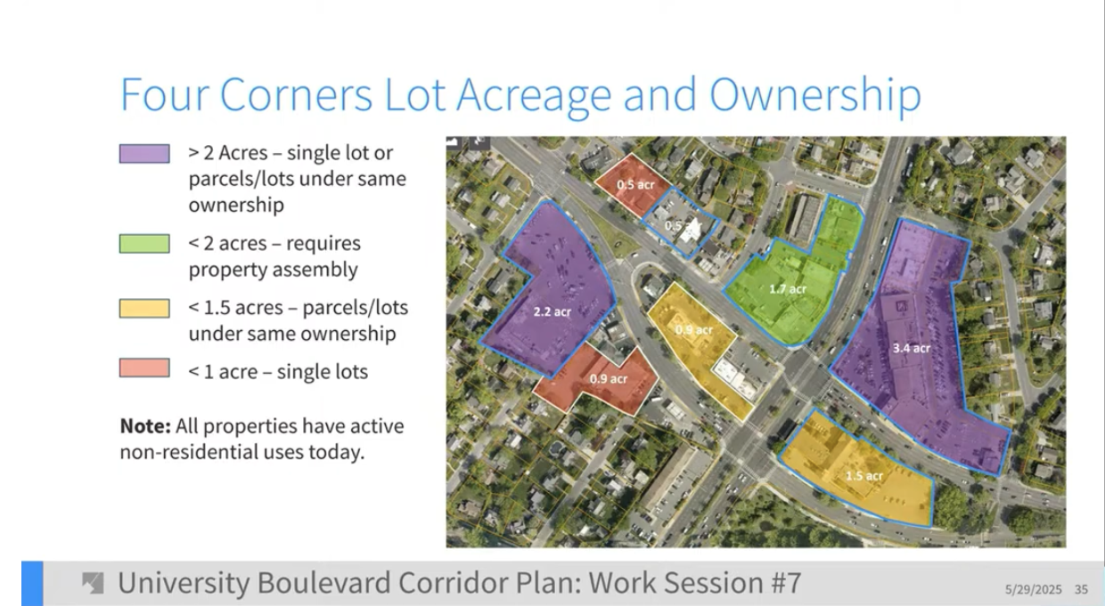

Slide 17
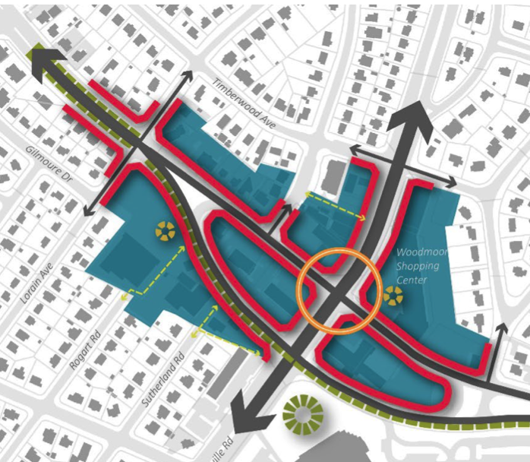
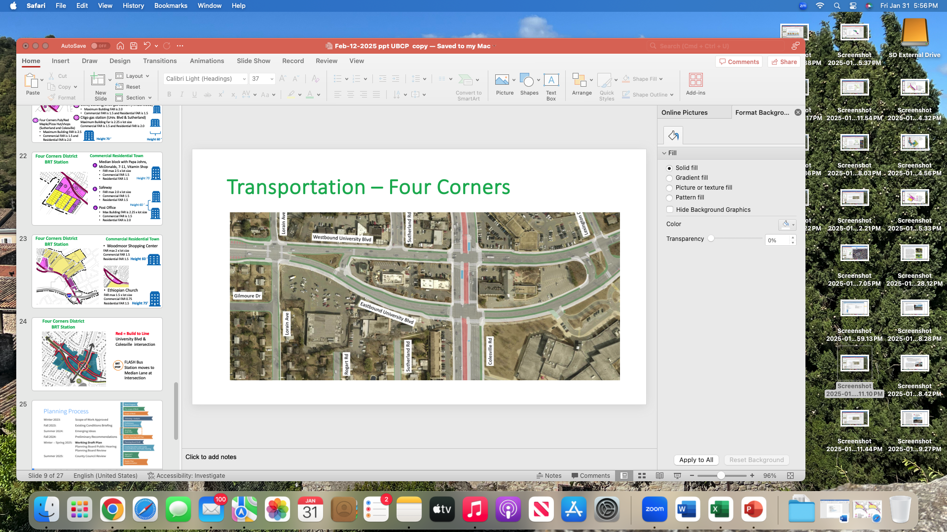
Four Corners District BRT Station
Red = Build to Line
University Blvd & Colesville intersection
FLASH Bus Stations in Median Lane at Intersection
BRT
STOP

Slide 18
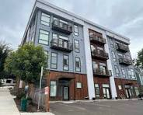
Four Corners District BRT Station
Commercial Residential Neighborhood
Homes in 10200-26 block of Colesville
Maximum building FAR is 1 x lot size
Residential only
Height 45’
Insurance Co on Sutherland
Maximum Building FAR is 1.25 x lot size Commercial FAR .05
Residential FAR 1.0
Height 40’

Slide 19
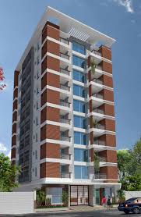
Four Corners District BRT Station
Commercial Residential Town
Dunkin Donuts and Vacant Offices (Lorain)
Maximum Building FAR is 3.0 x lot size
Commercial FAR is 1.5 and Residential FAR is 2.0
Vet and Various retail/office on Univ Blvd
Maximum Building Far is 2.25 x lot size
Commercial FAR is 1.5 and Residential FAR is 1.5
Four Corners Pub/Red Maple/Pizza Hut/shops (Sutherland and Colesville)
Maximum Building FAR is 2.5 x lot size
Commercial FAR is 1.5 and Residential FAR is 2.0
Utility building/Shell gas station (Timberwood)
Maximum Building FAR is 2.0 x lot size
Commercial FAR is 1.5 and Residential FAR is 1.5
Citgo gas station (Univ. Blvd & Sutherland)
Maximum Building Far is 2.25 x lot size
Commercial FAR is 1.5 and Residential FAR is 2.0
Height 100 ‘
Height 70 ‘
Height 60 ‘

Slide 20
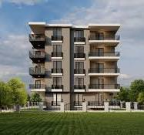
Four Corners District BRT Station
Commercial Residential Town
1
Median block with Papa Johns, McDonalds, 7-11, Vitamin Shop
FAR max 2.5 x lot size
Commercial FAR 1.5
Residential FAR 1.5
Post Office/Gas Stations
Max Building FAR is 2.25 x lot
Commercial FAR is 1.5
Residential FAR is 1.5
Safeway
FAR max 2.25 x lot size
Commercial FAR 1.5
Residential FAR 1.5
60 ‘ high
2
Height 75‘
3
Height 60‘

Slide 21
Four Corners District BRT Station
Commercial Residential Town
Woodmoor Shopping Center
FAR max 3 x lot size
Commercial FAR 1.5
Residential FAR 2.5
Height 60 ‘
Ethiopian Church
FAR max 2.5 x lot size
Commercial FAR 1. 5
Residential FAR 1.5
Height 75 ‘

